Slide 1
PPP Project Development Support
PRESENTATION AT THE 2nd QUARTER PPP UNIT CONSULTATIVE FORUM
JUNE 1 2017 – Abuja, Nigeria

Slide 2
OUTLINE
  Who is the AfDB
  AfDB focus for Africa – Hi Five’s
  AfDB in Nigeria
  AfDB/Nigeria PPP Partnership
  Bank Support for some PPPs in Nigeria
  Project Development Support
  Conclusion

Slide 3
Who is the AfDB?
One of the 6 Multi-lateral Development Banks; the others are
The World Bank, Asian Development Bank, Inter-American Bank,
the European Bank for Reconstruction and Development and
The Caribbean Development Bank
African Development Bank Group
The AfDB was founded following an agreement signed by member states on August 14, 1963, in Khartoum, Sudan, which became effective on September 10, 1964
AfDB
Headquartered in Abidjan, Côte d’Ivoire, the Bank Group has 80 member countries, comprising 54 regional member countries (RMC) and 26 non-regional member countries (NRMC).
The African Development Bank Today

Slide 4
Affiliates of the Group
African Development Bank
Established in 1964
ADB
African Development Bank Group
AfDB
NTF
ADF
African Development Fund
Established in 1972
Nigerian Trust Fund
Established in 1976

Slide 5
Mission and Objectives
To contribute effectively to the reduction of poverty in African
Countries
African Development Bank Group
To provide African Countries with necessary funding
and assistance to promote sustainable growth and progress
AfDB

Slide 6
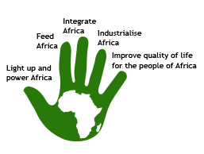
AfDB focus for Africa – Hi Five’s
African Development Bank Group
AfDB
The African Development Bank Today

Slide 7
AfDB in Nigeria
A total of USD 6.2 billion – of which:
USD 3.0 billion is Private Sector
USD 3.2 billion is Public Sector
African Development Bank Group
AfDB
6

Slide 8
AfDB/Nigeria PPP Partnership
The Bank participated in the Lekki – Epe Toll road
project motivating the participation of other lenders. A
total of $85 million was approved out of which $53mil
was approved based on project milestone.
The Bank is working with the Federal Government of
Nigeria in the implementation of the recently approved Power
Sector Recovery Plan
The Bank is currently working with the Ministry of Industry,
Trade & Investment towards the rehabilitation of its 23
Industrial Development Centers to Industrial Clusters
through PPPs.
  A grant of UA423,600 was been approved for
  the feasibility study
African Development Bank Group
AfDB
The African Development Bank Today
7

Slide 9
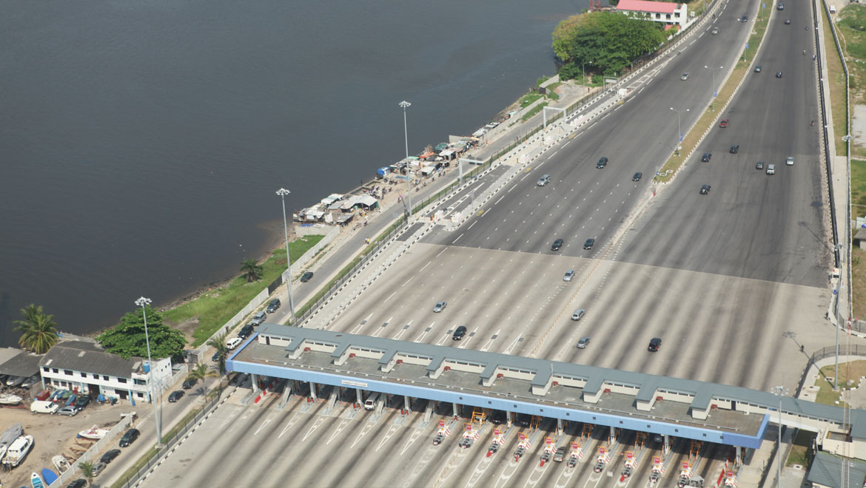
Bank Support for some PPPs in Nigeria: Lekki Epe Expressway Toll Road
African Development Bank Group
AfDB
Project Overview
$85million of 15year debt
First PPP in transport sector in Nigeria
Project has improved road safety along the corridor
Lower vehicle operating cost
Increased employment to the State
Improved road infrastructure and property prices

Slide 10
Project Development Support
S/N | NAME OF FUND | AREAs OF INTERVENTION | ACTIVITIES | USED IN NIGERIA?
1. | MIDDLE INCOME TECHNICAL ASSISTANE FUND | ALL SECTORS | Project Preparation Activities Capacity and Institutional Building Activities/Technical Assistance Activities that Promote the Private Sector & Regional Integration | Yes – BOA, FMITI, NEITI, OCEAP etc.
2 | NEPAD Infrastructure Project Preparation Fund (IPPF) | ICT • Transport • Energy • Water and Sanitation | Regional Project identification • Preparation, Workshops, Seminars in line with NEPAD Agenda • RECs Capacity Building | In progress
9

Slide 11
Project Development Support
S/N | NAME OF FUND | AREAS OF INTERVENTION | ACTIVITIES | USED IN NIGERIA?
3 | Sustainable Energy Fund For Africa (SEFA) | • Renewable Energy • Energy Efficiency | Project preparation for projects of total investment needs of USD 30-200 million (Support of projects with an independent power producer or within a PPP structure; sovereign entities are not eligible as project sponsors) • Contribution of equity to a Private equity fund • Creation of an enabling environment for private investments in sustainable energy | In Progress
4 | Nigeria Technical Cooperation Fund (NTCF) | Capacity Building & Regional Integration in the areas of: Science & Technology Human Development (Health & Education) Agriculture Public Administration, Business & Finance | Pre-feasibility and feasibility studies • Project identification • Preparation • Appraisal • Post-evaluation • Mid-term review • Rehabilitation of existing projects experiencing difficulties • Training • Capacity building | In progress
10

Slide 12
Project Development Support
S/N | NAME OF FUND | AREAS OF INTERVENTION | ACTIVITIES | USED IN NIGERIA?
5 | Infrastructure Consortium for Africa | Water Transport Energy ICT | Promoting increased investment in infrastructure in Africa, from both public and private sources. | Yes through WAPP https://www.icafrica.org/en/fund-finder/project-preparation-facilities-network/
6 | China Trust Fund | All sectors | Project identification, Preparation Studies
7 | Portugal Fund | Infrastructure, Renewable Energy, Agric, Water, Governance, Capacity Building & Private Sector Development | Project cycle activities including pre-feasibility and feasibility studies • Capacity building and human resource development • Policy and sector studies
8 | Bill & Melinda Gates Foundation | Multi-Sectors | As agreed by Foundation
11

Slide 13
Conclusion
The Bank’s New Business Delivery Model has PPPs enshrined in every sector. Because of this, we expect the following:
  To carry our more capacity building programs for different levels of government.
  To increase private sector engagement especially project developers concerns.
  To carry out a lot more engagement with the Federal Government on:
    The coordination of PPPs by the Office of the V.P;
    Driving the establishment of a project preparation fund
African Development Bank Group
AfDB
The African Development Bank Today
12

Slide 14
THANK YOU
Contact
African Development Bank Nigeria Country Department
8 Lake chad Crescent
Maitama, Abuja
+234 (9) 462 1030/76
African Development Bank Group
AfDB
The African Development Bank Today
13

